Slide 1
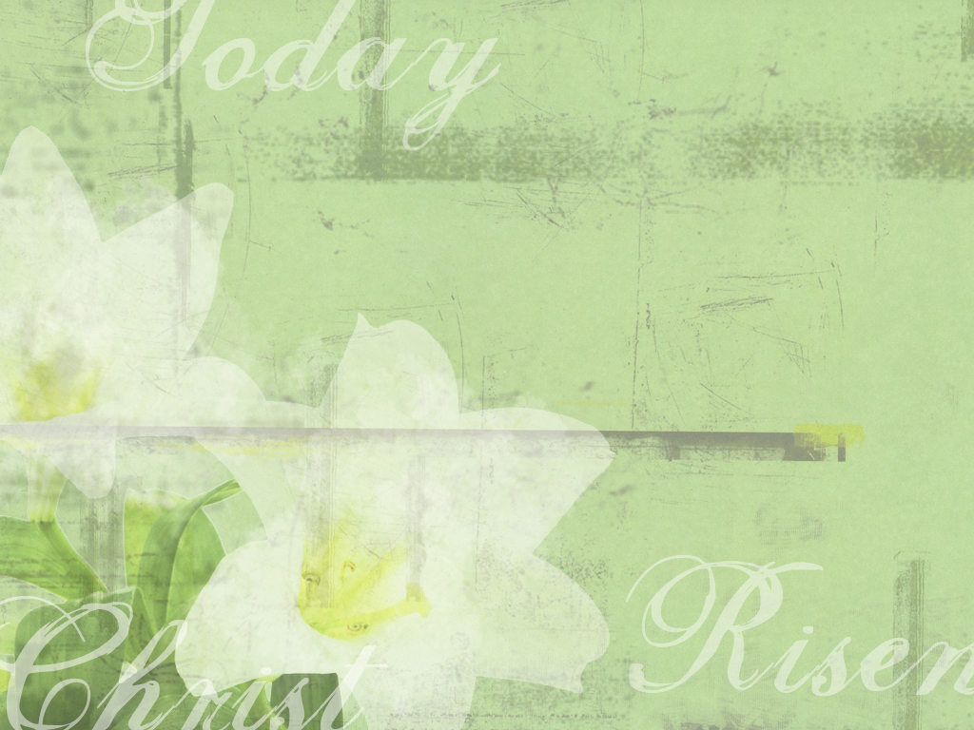
信息：「復活日的得勝」
Message： The Victory of Easter
邢承中 弟兄
Chen Chung Hsin
翻譯 Translator：傅玉雲

Slide 2
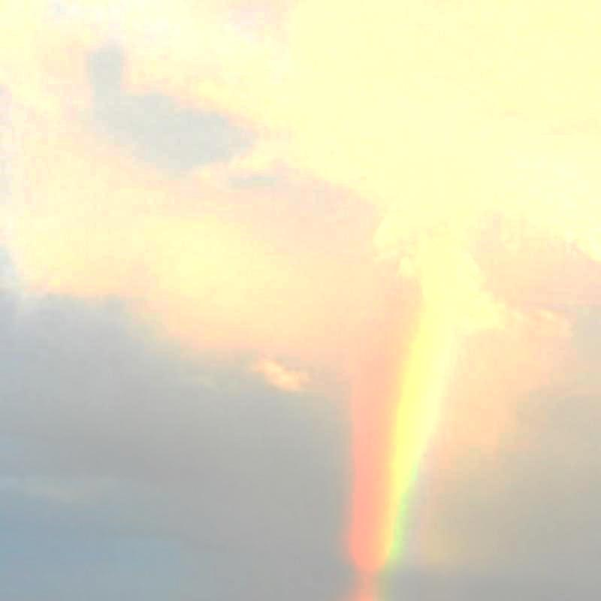
內容 Content
聖經經文 Bible Reading
  (路加福音 24:1-12) (Luke 24:1-12)
  (約翰福音 20:1-8) (John 20:1-8)
引言 Introduction
勝過罪 Victory over Sin
勝過死亡 Victory over Death
勝過隔絕 Victory over Separation
結語 Reflections

Slide 3
引言 Introduction
景象 Scene | 變換 Transformation | 得勝 Victory
空十字架 Empty Cross | 羞辱→榮耀 Shame→Glory | 勝過罪 Over Sin
空墳墓 Empty Tomb | 死亡→生命 Death→Life | 勝過死亡 Over Death
空裹頭巾 Empty Burial Cloth | 隔絕→同在 Separation→Togetherness | 勝過隔絕 Over Separation

Slide 4
勝過罪 Victory Over Sin
十字架的救恩滿足神
赦罪的應許
  在十架上，耶穌以無
  罪的生命代贖世人的
  罪行
  從此，羞辱的十字架
  成為榮耀的記號
  如同耶穌釘死在十架
  上，凡屬祂的，亦當
  將我們的罪性釘在十
  架上
The Salvation on the cross fulfills God’s promise to forgive sins
  On the cross, Jesus offered His sinless life for the forgiveness of our sins
  Hence, the cross transforms shame to glory
  Like Jesus who died on the cross, we who belong to Him should have also crucified the sin on the cross

Slide 5
勝過死亡 Victory Over Death
空墳墓滿足神賜復活
的生命的應許
  空墳墓見證神戰勝
  死亡的復活大能
  我們若在祂的死上與
  祂聯合，也必在祂的
  復活上與祂聯合
  當那日，我們必全然
  復活
The Salvation through the empty tomb fulfills God’s promise of our resurrection
  The empty tomb demonstrates God’s power over death and His power of resurrection
  If we have been united with him in his death, we will certainly also be united with him in his resurrection
  On that day, we will be raised to eternal life

Slide 6
勝過隔絕 Victory Over Separation
捲著的裹頭巾滿足神
與我們同在的應許
  空裹頭巾表明祂是活
  的救主；祂已超越時
  空
  我們得以脫離隔絕，
  與神親近
  祂願隨時隨地與我們
  同在，以保護，供應，
  與眷顧幫助我們
The Salvation through the folded up burial cloth fulfills God’s promise to be with us
  The empty burial cloth demonstrates that He is a living Savior, who has transcended over time and space
  We are therefore no more separated from God
  He is willing to be with us and help us with His protection, provision, and providence

Slide 7
結語 Reflections
在此復活主日，我們當一同慶祝主的復活，並祂復活大能帶給我們生命的影響
這復活大能已勝過罪，死亡，與隔絕
藉這復活大能，我們罪得赦免，得賜永生，並得耶穌基督為生命的主
On this day of Ester, Let’s celebrate Christ’s victory and resurrection, and the effect of the power of resurrection on our lives
This power has overcome sin, death and separation
Through this power, we are redeemed, given eternal life and having Jesus as our personal savior and counselor

