Slide 1
Message:
“Adjustment Appointments”
Philippians 2:1-13
Patrick Lee
主日信息：
『調整預約』
(腓 2:1-13)
翻譯：傅玉雲

Slide 2
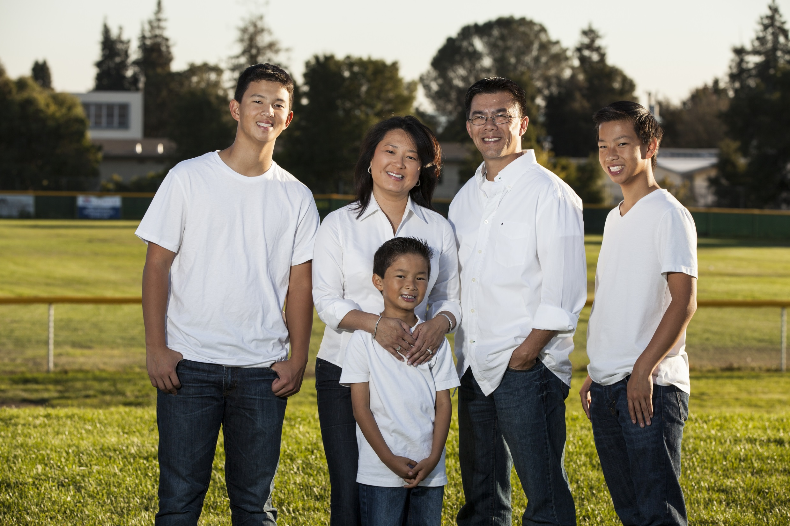
The LEE Family
Tyler
Pat
Cyndi
Evan
Max

Slide 3
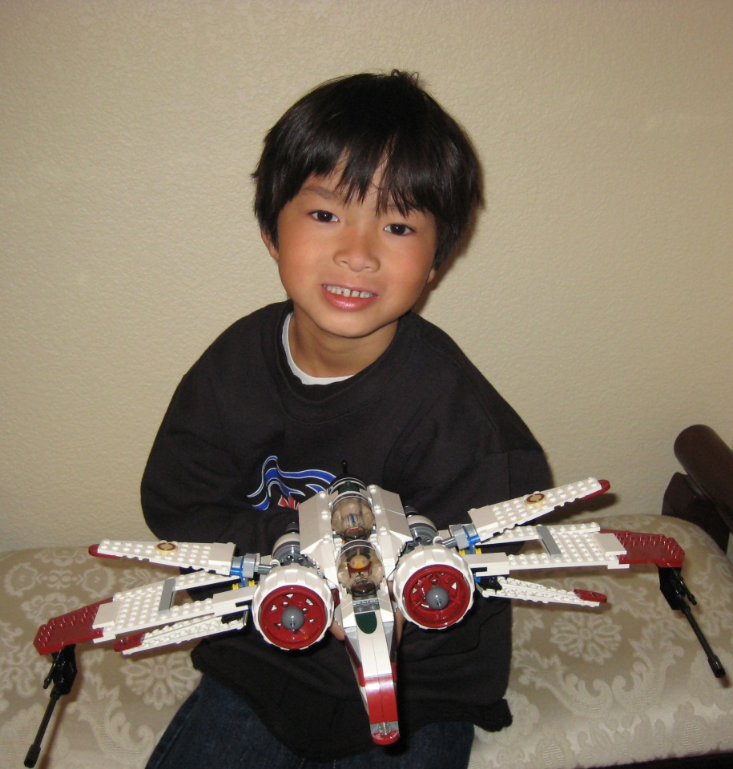
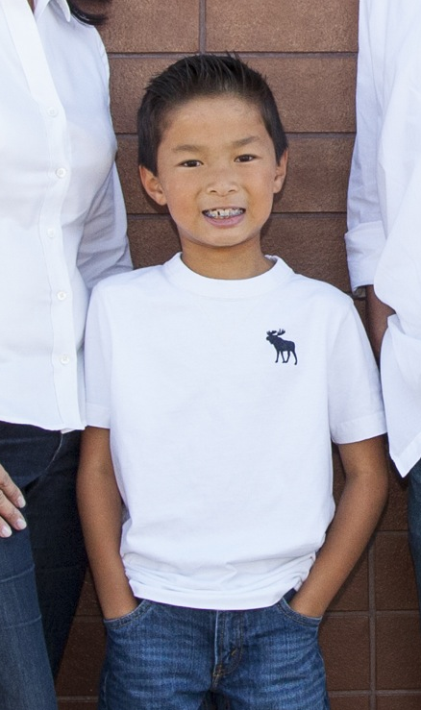
Max
5th Grade
Redwood Christian

Slide 4

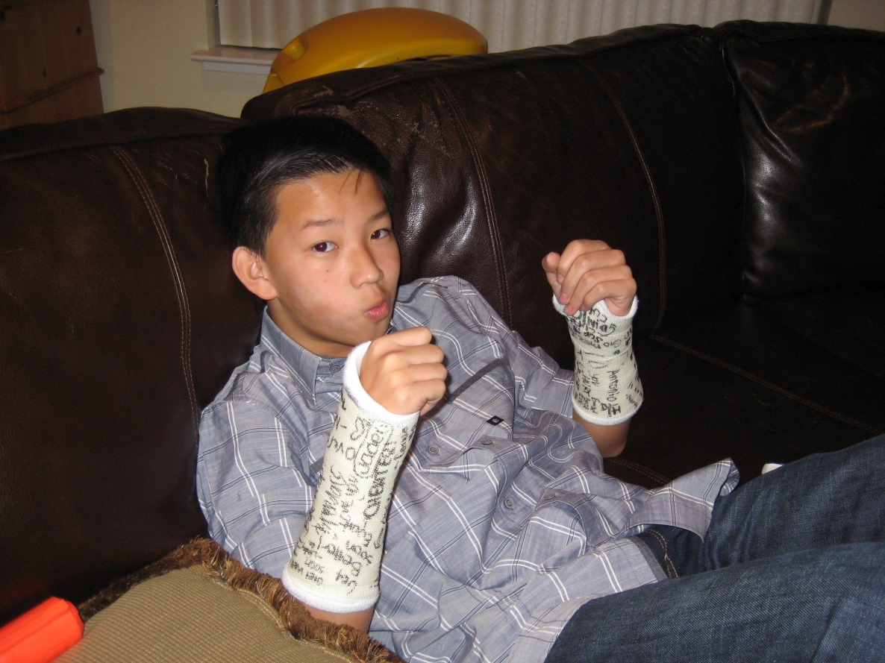
Evan
9th Grade
Castro Valley High

Slide 5
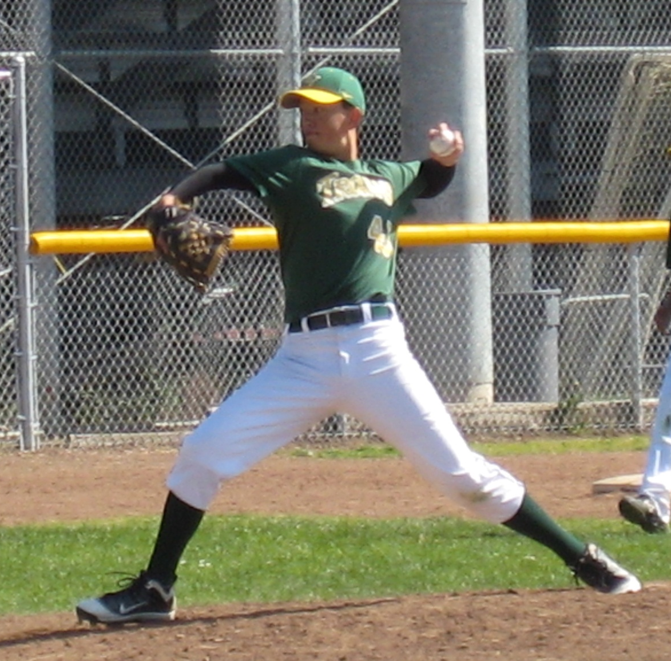
Tyler
12th Grade
Castro Valley High

Slide 6

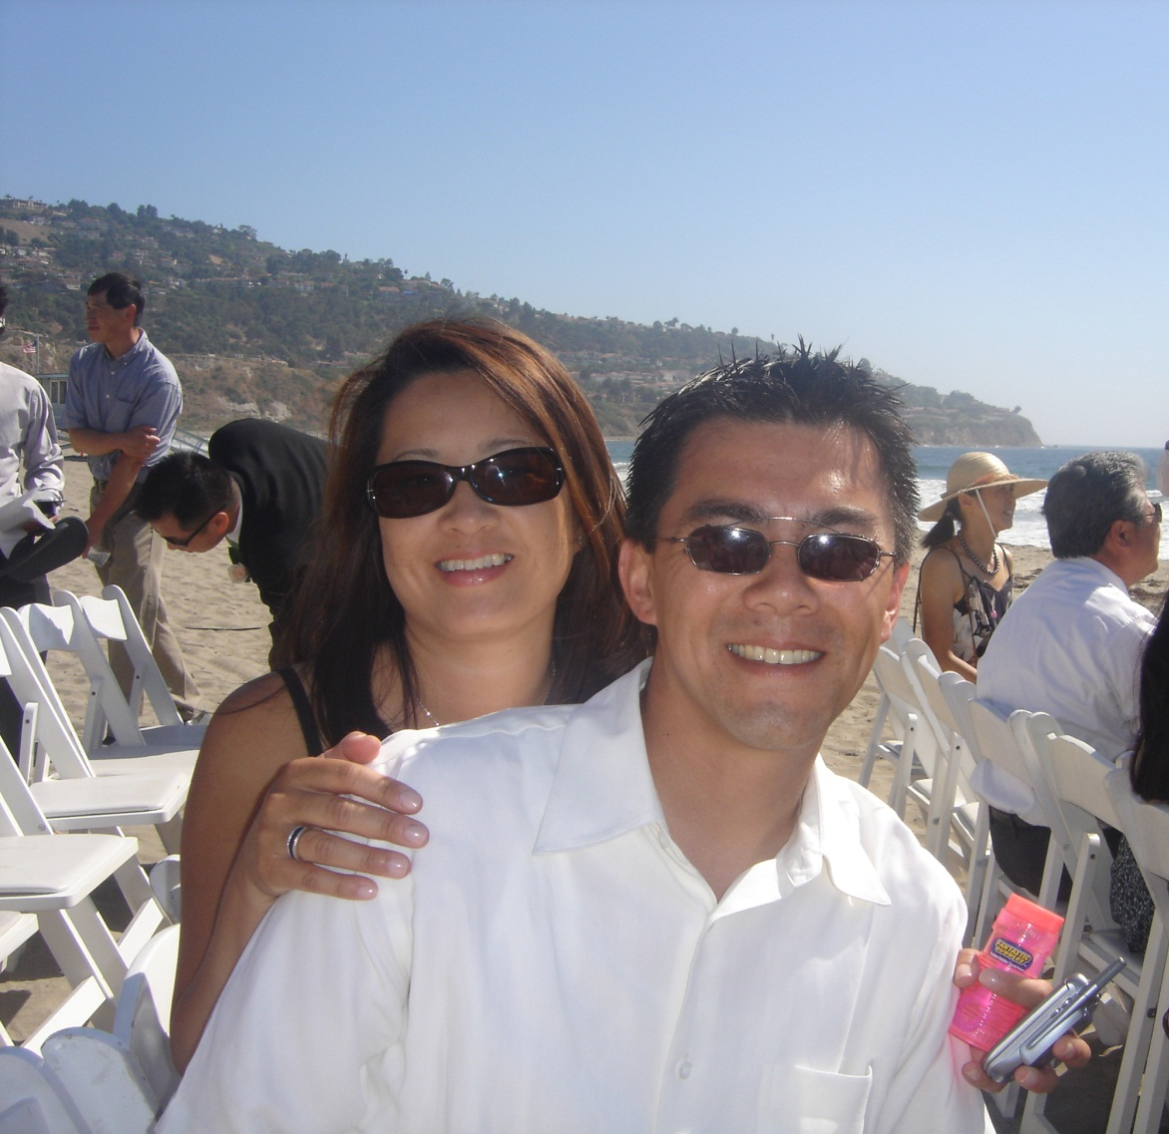



Slide 7




Slide 8
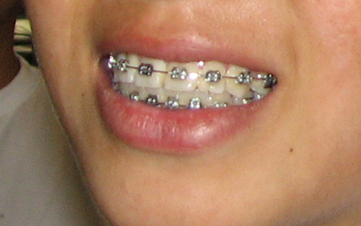

Slide 9
Adjustments -
Prescribed,
Painful,
Productive,
events towards desired results

Slide 10
Philippians 2:1-13

Slide 11
2 Things to Consider:
1) Being HUMBLE eases the DISCOMFORT (v. 1-11)

Slide 12
“humility” =
the proper estimation compared to God

Slide 13
The Humility of Jesus -
Jesus became a servant (v. 7)
Jesus became our sacrifice (v. 8)
Jesus became our Savior (v. 9-11)

Slide 14
2 Things to Consider:
2) Allowing GOD to work eases the PROGRESS (v. 12-13)

Slide 15
“work out” =
to maximize the potential

Slide 16
2 Corinthians 12:9-10
But he said to me, “My grace is sufficient for you, for my power is made perfect in weakness.” Therefore I will boast all the more gladly about my weaknesses, so that Christ’s power may rest on me. That is why, for Christ’s sake, I delight in weaknesses, in insults, in hardships, in persecutions, in difficulties. For when I am weak, then I am strong.

Slide 17
God is too good to be unkind,
He is too wise to be confused,
If I cannot trace His hand,
I can always trust His heart.

Slide 18
Our Challenge:
to not MISS our next appointment

