Slide 1

11302014
Message: “Trust in the Lord”
『專心仰賴主』
(Proverbs 箴言 3:5-6)
Speaker: Pastor Balex / Interpreter: Kasindy Chang

Slide 2


Mottos (人生左右銘) = words to live by, wisdom,
advices…

Slide 3

你要專心仰賴耶和華，不可倚靠自己的聰明，
在你一切所行的事上都要認定他，他必指引你的路。
“Trust in the Lord…” = positive encouragement
“Lean not on your own…” = negative reminder
“In all your ways…” = positive advice
“He will make your path…” = Important result

Slide 4
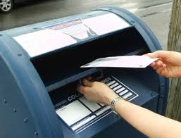

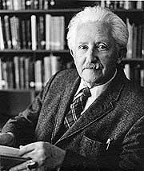


I. Trust in the Lord
“Trust” is to have “faith”
Erik Erickson
“Trust” is in our daily activities

Slide 5


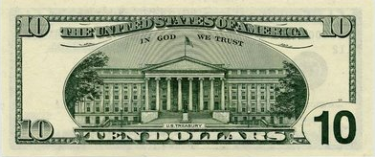
Who and What do we trust?
In God
We Trust
“In Goods We Trust”
“Trust in the Lord”

Slide 6


“Trust in the Lord
with all your heart”

Slide 7

I guess?
Mm…I’ll try?
Maybe?

Slide 8
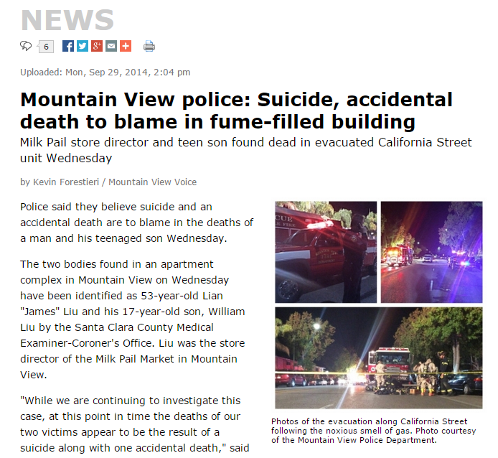
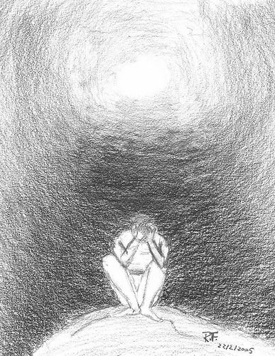


II. Lean not on your own understanding

Slide 9


III. In all your ways acknowledge HIM
There is a way that seems right to a man, but in the end
it leads to death (Provb. 14:12)
有一條路，人以為正，至終成為死亡之路 (箴14:12)

Slide 10



Slide 11

但義人的路好像黎明的光，越照越明，
直到日午。 (箴 4:18)

Slide 12

In his heart a person plans his course, but the Lord
determines his steps. (Provb. 16:9)
人心籌算自己的道路，
惟耶和華指引他的腳步。
(箴 16:9)

