Slide 1
Understanding God’s Grace In Depression Pt 2:
By going to God

Slide 2
Notes:
Today we are going to look at why we worry and what to do when we worry
The reason why we are going to talk about this-worrying can rob you from enjoying life
Quick thing from yesterday
Ex I was looking forward hanging w/ my wife instead we fought over my knee
Some of you are not enjoying life, enjoying your relationships, your job, families, because worrying has robbed you from enjoying them-think about that kid, or that husband
There was a couple that had a daughter dating someone they didn’t want
You’re worried because they spend too much time on their video games or you tried fixing them
The text we are going to look at will show us a very powerful and profound teaching
If we seek anything other than God, we will live a life of worry

Slide 3
25 “Therefore I tell you, do not be anxious about your life, what you will eat or what you will drink, nor about your body, what you will put on. Is not life more than food, and the body more than clothing?

Slide 4
26 Look at the birds of the air: they neither sow nor reap nor gather into barns, and yet your heavenly Father feeds them.

Slide 5
Are you not of more value than they?

Slide 6
27 And which of you by being anxious can add a single hour to his span of life?[g] 28 And why are you anxious about clothing? Consider the lilies of the field, how they grow: they neither toil nor spin, 29 yet I tell you, even Solomon in all his glory was not arrayed like one of these. 30 But if God so clothes the grass of the field, which today is alive and tomorrow is thrown into the oven,

Slide 7
will he not much more clothe you, O you of little faith?

Slide 8
31 Therefore do not be anxious, saying, ‘What shall we eat?’ or ‘What shall we drink?’ or ‘What shall we wear?’ 32 For the Gentiles seek after all these things, and your heavenly Father knows that you need them all.

Slide 9
3 But seek first the kingdom of God and his righteousness, and all these things will be added to you.

Slide 10
34 “Therefore do not be anxious about tomorrow, for tomorrow will be anxious for itself. Sufficient for the day is its own trouble

Slide 11
Notes:
What the text is saying, the next time you worry, look at the birds in the air
And reflect if God would care for them, how much more
Stop looking at finding the perfect job, family
Becaus then you’ll keep thinking how much more do I have to do
But, look at the birds in the air, look at how we don’t have to worry

Slide 12
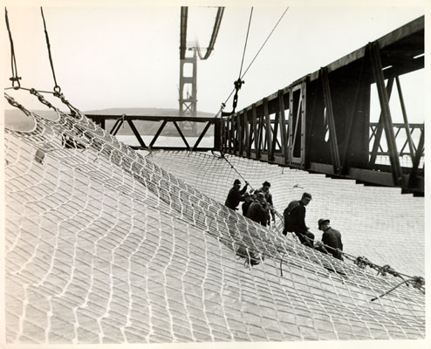
Notes:
What would life look like if you didn’t worry
Story of Golden Gate Bridge

Slide 13
Seek the kingdom of God

Slide 15

Ask for feelings report
Seek professional help
Know your limits
Notes:
Let me just share a few thoughts to guide you if you are someone you may know if you struggle w/ depression
Ask for a weather report (Eckman)
What do you do when you look up the weather report
Find out what the weather is, what are the chances that it’ll rain
You do that to do what? Work w/ it
Asking for how are you doing
So, you can work w/ it
But, it makes the person feel safe to share what is going on inside
You are also communicating that it’s okay to have those feelings
Doing this, you will allow that person to have a safe place to let their feelings out
Lia example, caged pet
Keeping the feelings caged up, will make it worst, angrier, and harder and harder
But, to let someone know that they can feel safe to share their feelings
No where else can they do that
Seek for professional help
If you’re not sure, ask your doctor
Talk to a therapist
If you have a child-go w/ your child
If meds are suggested, proceed w/ caution
Meds help because it regulates some of the chemicals that are misfiring
But, remember, when seeking help-give the counseling 3 times
Meds, can take up to 3 months-but they are very very powerful
Ask a professional on what it looks like to parent someone that has severe depression
Keep boundaries
If you’re child has social phobia or is very introverted
Protect them, work w/ it
If you’re child has a tendency to stay up late or can play video games for hours and hours
Cut it off
Show controled consequences before the consequences controls them
But, replace it w/ a relationship
NPR story of boy that ate ice cream and looked into the parents eyes

Slide 16
this is a slide title
Here you have a list of items
And some text
But remember not to overload your slides with content
You audience will listen to you or read the content, but won’t do both.

Slide 17
big concept
Bring the attention of your audience over a key concept using icons or illustrations

Slide 18
you can also split your content
White
Is the color of milk and fresh snow, the color produced by the combination of all the colors of the visible spectrum.
Black
Is the color of coal, ebony, and of outer space. It is the darkest color, the result of the absence of or complete absorption of light.

Slide 19
in two or three columns
Yellow
Is the color of gold, butter and ripe lemons. In the spectrum of visible light, yellow is found between green and orange.
Blue
Is the colour of the clear sky and the deep sea. It is located between violet and green on the optical spectrum.
Red
Is the color of blood, and because of this it has historically been associated with sacrifice, danger and courage.

Slide 20
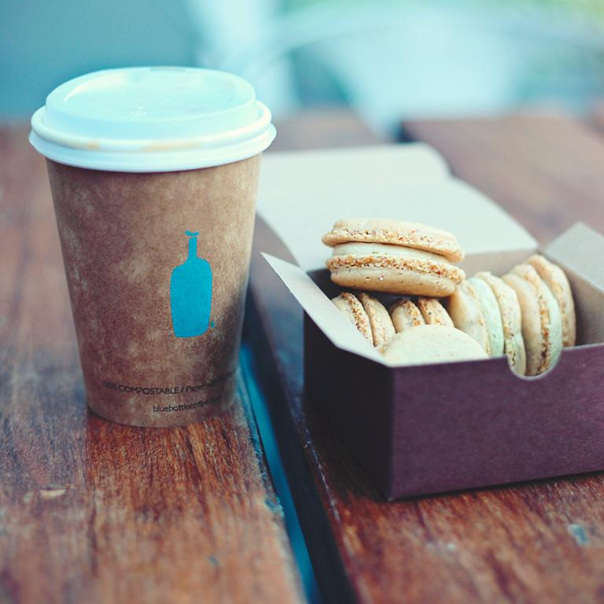
a picture is worth a thousand words
A complex idea can be conveyed with just a single still image, namely making it possible to absorb large amounts of data quickly.

Slide 21
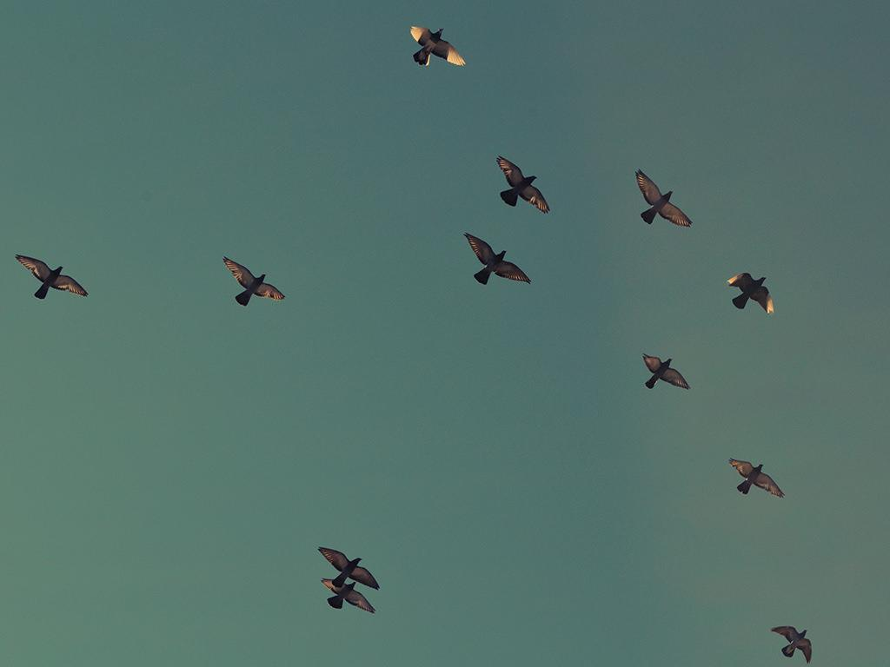
want big impact?
USE BIG IMAGE

Slide 22
use charts to explain your ideas
WHITE
GRAY
BLACK

Slide 23
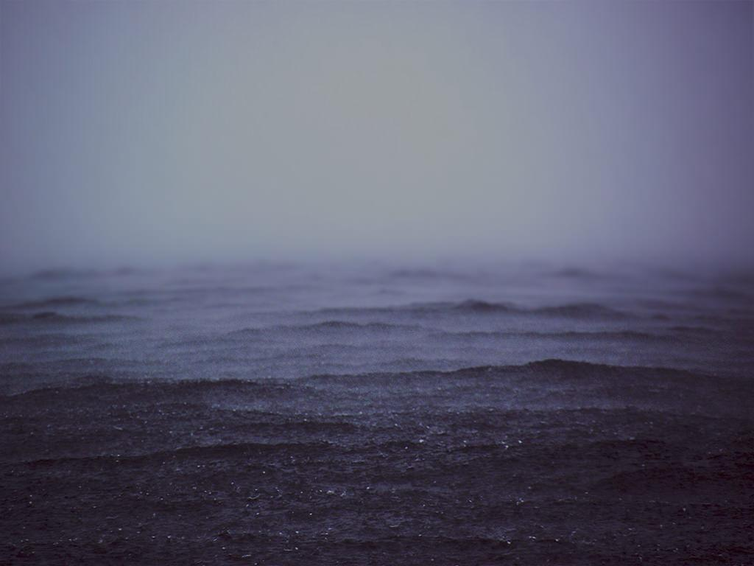
and tables to compare data
 | A | B | C
YELLOW | 10 | 20 | 7
BLUE | 30 | 15 | 10
ORANGE | 5 | 24 | 16

Slide 24


maps
OUR OFFICE

Slide 25
89,526,124
whoa! that’s a big number,
aren’t you proud?

Slide 26
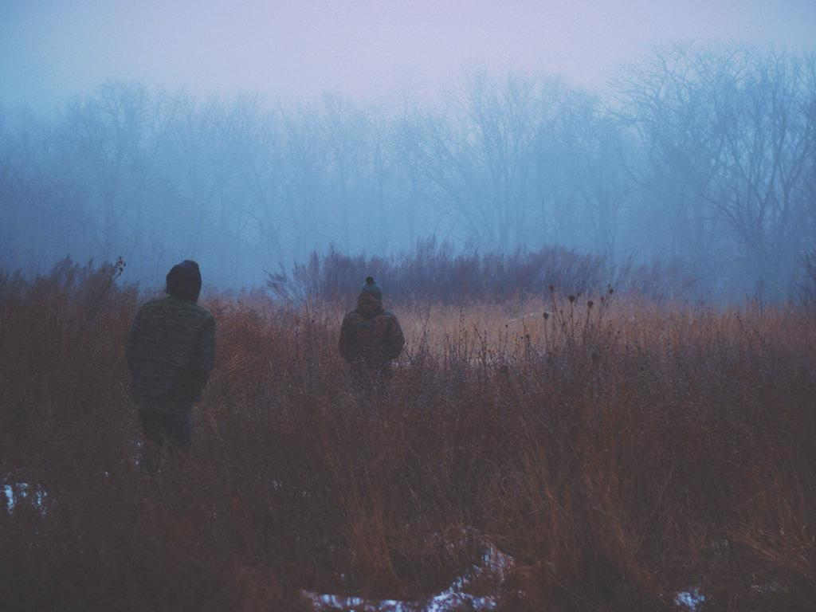
89,526,124$
185,244 users
100%
that’s a lot of money
and a lot of users
total success!

Slide 27
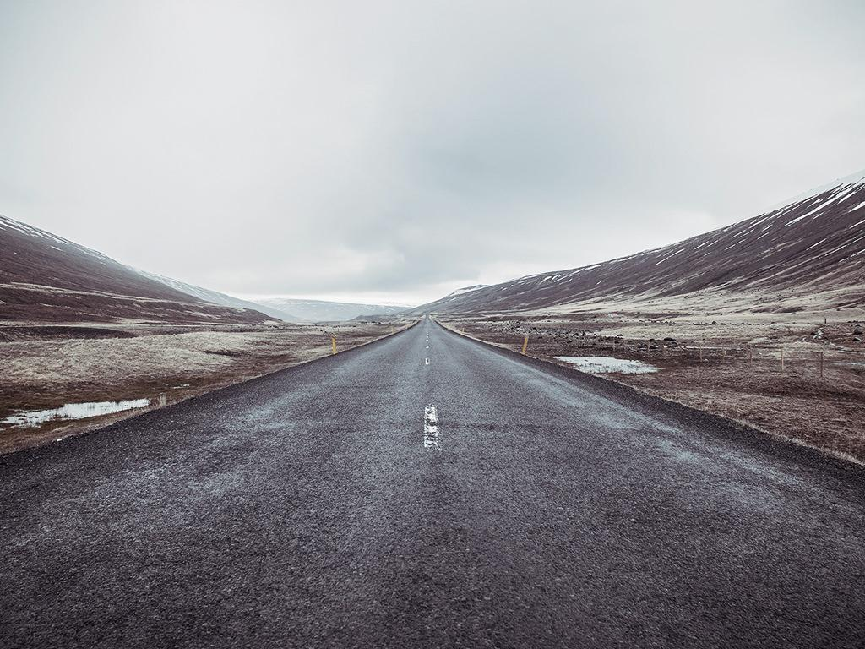
our process is easy
FIRST
SECOND
LAST

Slide 28
let’s review some concepts
Yellow
Is the color of gold, butter and ripe lemons. In the spectrum of visible light, yellow is found between green and orange.
Blue
Is the colour of the clear sky and the deep sea. It is located between violet and green on the optical spectrum.
Red
Is the color of blood, and because of this it has historically been associated with sacrifice, danger and courage.
Yellow
Is the color of gold, butter and ripe lemons. In the spectrum of visible light, yellow is found between green and orange.
Blue
Is the colour of the clear sky and the deep sea. It is located between violet and green on the optical spectrum.
Red
Is the color of blood, and because of this it has historically been associated with sacrifice, danger and courage.

Slide 29
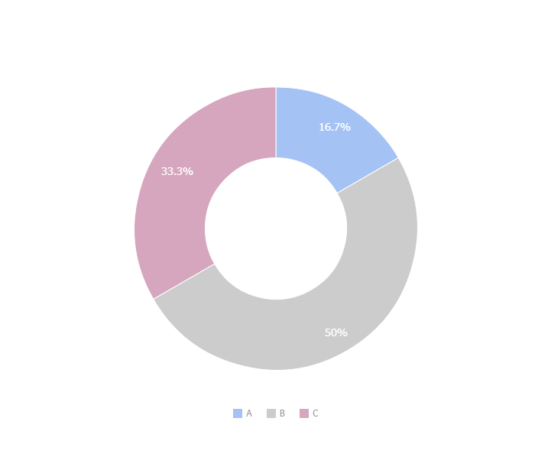
you can copy&paste graphs from google sheets

Slide 30
android project
Show and explain your web, app or software projects using these gadget templates.
Place your screenshot here

Slide 31
iPhone project
Show and explain your web, app or software projects using these gadget templates.
Place your screenshot here

Slide 32
tablet project
Show and explain your web, app or software projects using these gadget templates.
Place your screenshot here

Slide 33
Place your screenshot here
desktop project
Show and explain your web, app or software projects using these gadget templates.

Slide 34
thanks!
ANY QUESTIONS?
You can find me at:
@username
user@mail.me

Slide 35
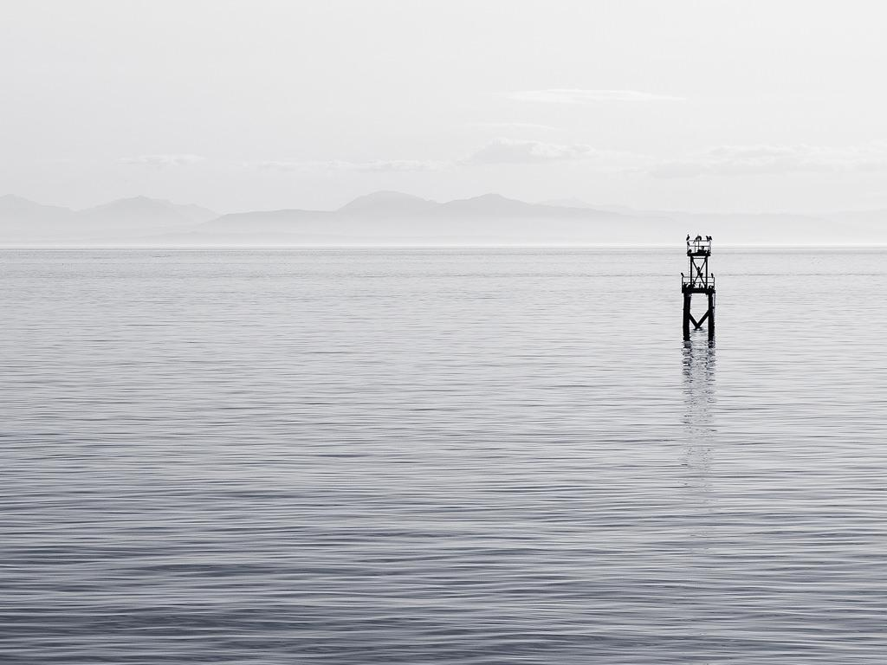
credits
Special thanks to all the people who made and released these awesome resources for free:
Presentation template by SlidesCarnival
Photographs by Unsplash

Slide 36

presentation design
This presentations uses the following typographies:
Titles: Homemade Apple
Body copy: Raleway
You can download the fonts on this page:
https://www.google.com/fonts#UsePlace:use/Collection:Homemade+Apple|Raleway:400,700
Click on the “arrow button” that appears on the top right
You don’t need to keep this slide in your presentation. It’s only here to serve you as a design guide if you need to create new slides or download the fonts to edit the presentation in PowerPoint®

Slide 37
SlidesCarnival icons are editable shapes.
This means that you can:
Resize them without losing quality.
Change fill color and opacity.
Isn’t that nice? :)
Examples:

Slide 38
😉
Now you can use any emoji as an icon!
And of course it resizes without losing quality and you can change the color.
How? Follow Google instructions https://twitter.com/googledocs/status/730087240156643328
✋👆👉👍👤👦👧👨👩👪💃🏃💑❤😂😉😋😒😭👶😸🐟🍒🍔💣📌📖🔨🎃🎈🎨🏈🏰🌏🔌🔑 and many more...

